Slide 1

Lambda Expressions
Pointers to Methods
Lambda Syntax
Sorting and Filtering
Functional Interfaces

Slide 2

See Also
https://docs.oracle.com/javase/tutorial/java/javaOO/lambdaexpressions.html
http://www.codejava.net/java-core/the-java-language/java-8-lambda-listener-example
Notes:
Some additional information on concurrency

Slide 3
How it Looks
JButton bt = new JButton("Press Me");
bt.addActionListener(new PressHandler());
bt.addActionListener(new ActionListener() {
@Override
public void actionPerformed(ActionEvent e) {
System.out.println("Pressed 2");
}
});
bt.addActionListener( e -> System.out.println("Pressed 3") );
I see this takes an ActionListener which has only one method.
I will create an object that implements it using your code.
ALERT
These are the parameters to the new method.
This is the code for the new method.

Slide 4
Pointers to Functions
interface MathOnTwo {
public int doMath(int first, int second);
}
class AddTwo implements MathOnTwo {
@Override
public int doMath(int first, int second) {
return first + second;
}
}
class SubtractTwo implements MathOnTwo {
@Override
public int doMath(int first, int second) {
return first - second;
}
}
public class Tinker {
static void process(MathOnTwo operation) {
System.out.println("-----");
System.out.println(operation.doMath(10, 20));
System.out.println(operation.doMath(0, 100));
System.out.println(operation.doMath(-5, 5));
}
public static void main(String[] args) {
MathOnTwo op = new AddTwo();
process(op);
op = new SubtractTwo();
process(op);
MathOnTwo opMult = (a,b) -> a*b;
process(opMult);
process( (a,b) -> a*b );
}
}

Slide 5
Syntax
interface MathOnTwo {
public int doMath(int f, int s);
}
interface Speak {
public void sayHi();
}
interface MathOnOne {
public int doMath(int first);
}
Use parenthesis for zero or more-than-one parameters.
Use braces {} for multiple instructions.
The “return” is understood for simple expressions.
If you use braces you must explicitly “return” a value.
Speak cow = ()->System.out.println("Mooo");
Speak farmer = ()->System.out.println("Hello");System.out.println("There");
Speak pig = ()->{System.out.println("Oink");System.out.println("Oink");};
MathOnOne square = v -> v*v;
square = (v) -> {return v*v;};
square = v -> {int x=v;x=x*v;return x;};
square = v -> {
int x=v;
x = x * v;
return x;
};

Slide 6
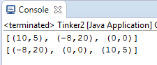
Comparator
class ComparePointX implements Comparator<Point> {
@Override
public int compare(Point p, Point q) {
return p.getX()-q.getX();
}
}
List<Point> points = new ArrayList<Point>();
points.add(new Point(10,5));
points.add(new Point(-8,20));
points.add(new Point(0,0));
System.out.println(points);
points.sort(new ComparePointX());
points.sort((p,q) -> p.getX()-q.getX());
System.out.println(points);

Slide 7

Double Colon
public class Tinker {
static int average(int one, int two) {
return (one+two)/2;
}
static void process(MathOnTwo operation) {
System.out.println("-----");
System.out.println(operation.doMath(10, 20));
System.out.println(operation.doMath(0, 100));
System.out.println(operation.doMath(-5, 5));
}
public static void main(String[] args) {
process( (a,b) -> a*b );
process(Tinker::average);
process(Math::min);
process(Math::max);
}
}
interface MathOnTwo {
public int doMath(int f, int s);
}

Slide 8
Functional Interfaces
import java.util.function.BinaryOperator;
import java.util.function.IntBinaryOperator;
static void process(MathOnTwo operation)
static void process(BinaryOperator<Integer> operation) {
System.out.println("-----");
System.out.println(operation.apply(10, 20));
System.out.println(operation.apply(0, 100));
System.out.println(operation.apply(-5, 5));
}
static void process(IntBinaryOperator operation) {
System.out.println("-----");
System.out.println(operation.applyAsInt(10, 20));
System.out.println(operation.applyAsInt(0, 100));
System.out.println(operation.applyAsInt(-5, 5));
}

Slide 9
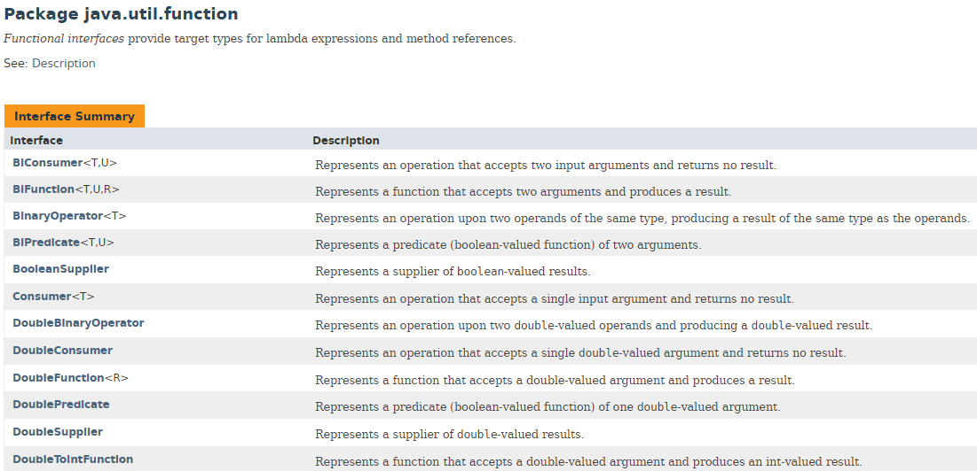
Many, Many More …

Slide 10

Collection Filtering
List<Message> messages = board.getMessages();
List<String> nmsList = new ArrayList<String>();
nmsList.add("John");
nmsList.add("Jan");
List<Message> use = new ArrayList<Message>();
for(Message m : messages) {
if(nmsList.contains(m.getSender())) {
use.add(m);
}
}
System.out.println(use);

Slide 11
foreach
List<Message> messages = board.getMessages();
List<String> nmsList = new ArrayList<String>();
nmsList.add("John");
nmsList.add("Jan");
List<Message> use = new ArrayList<Message>();
messages.forEach(m->{
if(nmsList.contains(m.getSender())) {
use.add(m);
}
});
use.forEach(m->System.out.println(m));

Slide 12
streams
List<Message> messages = board.getMessages();
List<String> nmsList = new ArrayList<String>();
nmsList.add("John");
nmsList.add("Jan");
List<Message> use = new ArrayList<Message>();
List<Message> use = messages.stream()
.filter(m->nmsList.contains(m.getSender()))
.collect(Collectors.toList());
use.forEach(m->System.out.println(m));

Slide 13

Tinkering
Type in the math processing example. Add a square-root operation.
Create a list of integer values. Use a “predicate” from the “java.util.function” package to find all the odd values.
Use a lambda to sort the list of chat messages by sender.

